Slide 1




Rent@SG – A MERN Stack Application
Made By: Jason Haw CT0369425D

Slide 2


Table of contents
01
02
Selection Criteria
Problem Statement
03
04
Proposed Idea
Tech Stack
OUR PRODUCTS

Slide 3

Table of contents
05
06
Project Goals
Achievements
07
08
Gannt Chart
References
OUR PRODUCTS

Slide 4


Selection Criteria
Our logo
Must be able to solve real world problems
Must be a full stack application which uses popular frameworks
Must be original and feasible to achieve within 30 weeks

Slide 5

Problem Statement
Problem: Singapore’s rental market is at its peak[1] and rental scams[2] are on the rise. Landlords face challenges when looking out for potential tenants. Tenants face challenges when looking for a place to rent.
Rental has increased as much as 70%[3] and rental scams has soared from 192 cases to 979 cases[2] in the year of 2022.
Landlords’ Challenges: Need to constantly do background checks on tenants and ultimately bear the agent’s cost for sourcing of tenants[3].
Tenants’ Challenges: Question on the legitimacy of the venue and dispute against unreasonable claims towards rental deposits[3].

Slide 6
Proposed Idea
To develop a full-stack application to solve all these issues.
Rent@SG will be the middleman between the tenant and the landlord.
To prevent scam listings, landlords will have to login and get authenticated via Sing-Pass API to be able to list on the application.
Landlords will have to get verified by another landlord through a physical visit to the unit to authenticate the legitimacy of the venue.
Rent@SG tenants will be able to login without Sing-Pass however they will be required to fill in details, so that the application can profile them and recommend to the landlords as needed.
Rent@SG will prepare the tenancy agreement and charge 5-10% of the 1st month’s rent so as to cover maintenance cost for running the application
Target Audience: Public(foreigners + Sgeans) + HDB landlords

Slide 7
IS THIS IDEA TRULY ORIGINAL?
LETS COMPARE!

Slide 8

Platform comparison
 | Rent@SG | 99 co | ilivesg | Carousell
Sing-Pass Verification
Tenant Profiling
Landlord verification
Agent Fees | 5-10% x 1 month rent | 100% x 1/2 month rent | 50%/0%

Slide 9
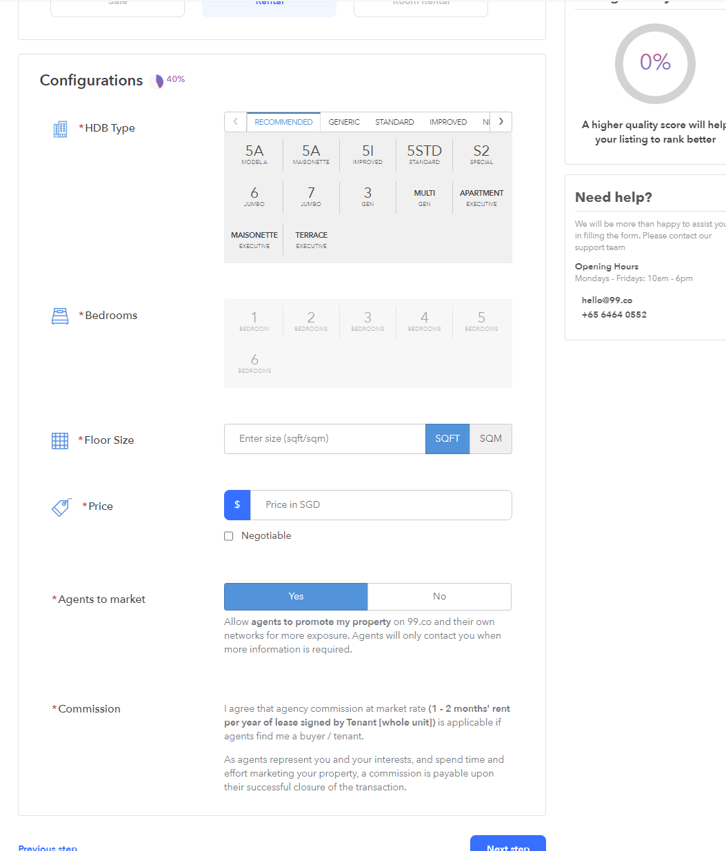
Platform comparison – 99.co

Slide 10
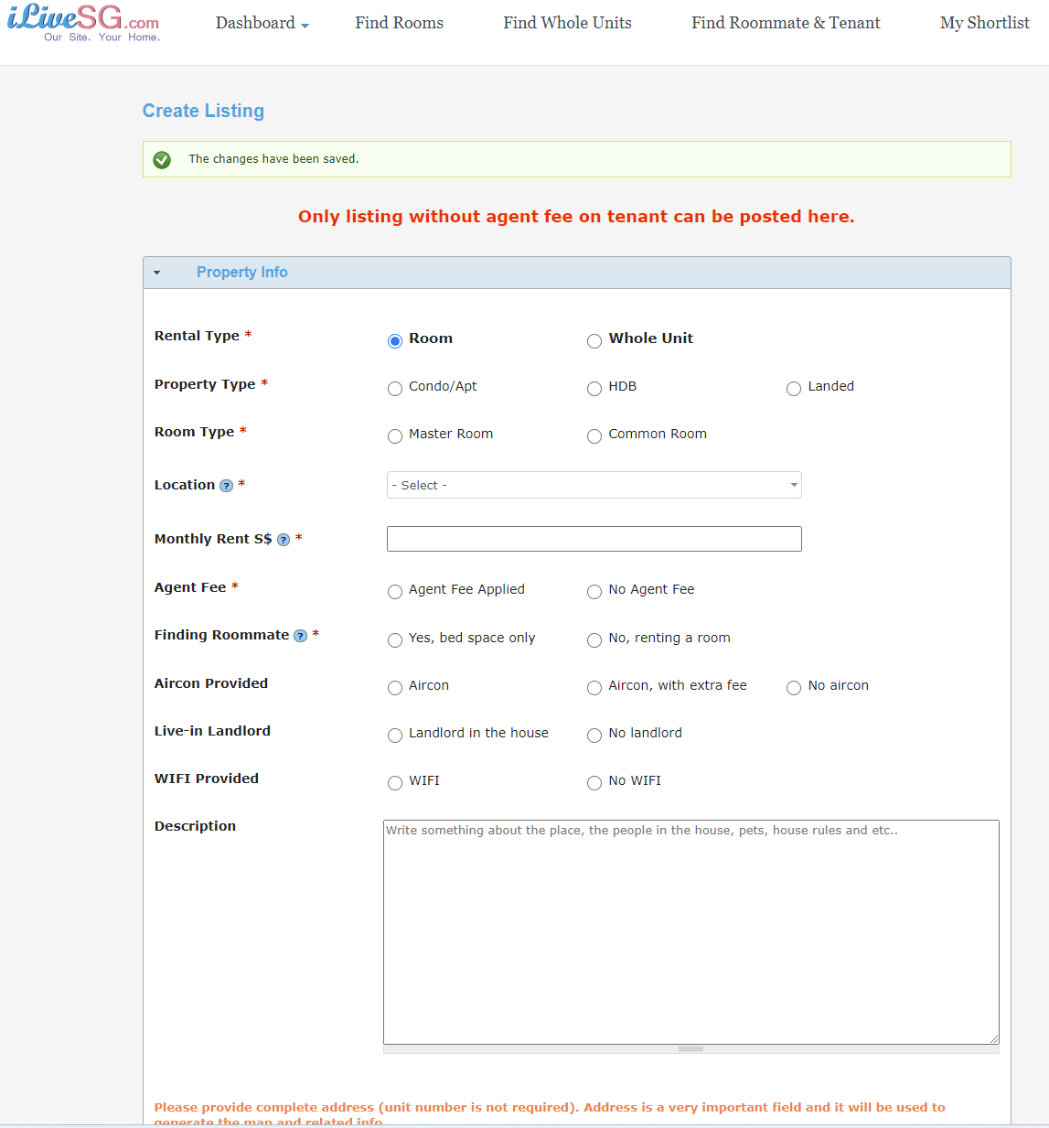
Platform comparison – ilivesg

Slide 11
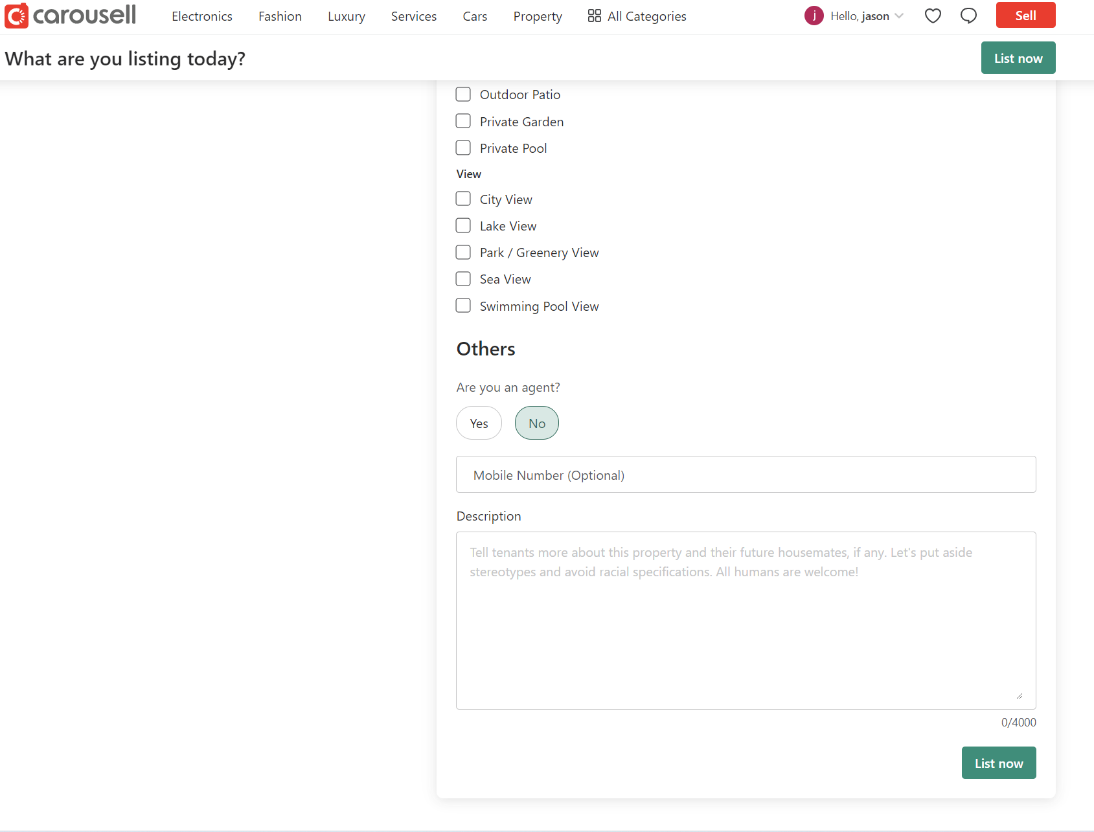
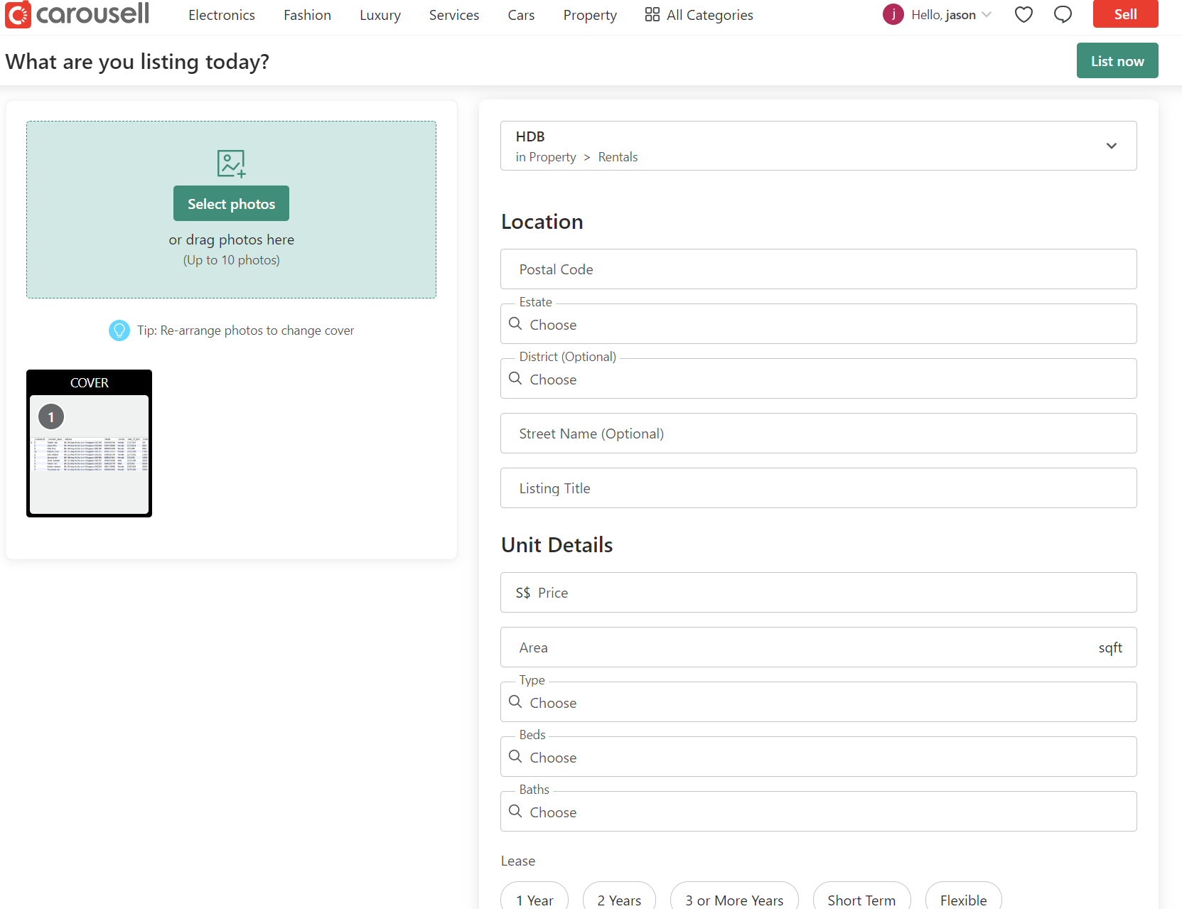
Platform comparison – carousell

Slide 12
Tech Stack - MERN
Frontend | ReactJs, NextJs, CSS with Bootstrap, HTML, Javascript, Jest, React-Bootstrap
Backend | NodeJs, ExpressJs, MongoDB, Morgan, Multer
Server Hosting platform | Heroku
Project Planning | Jira – Agile Kanban
Version Control | Github
Designing Tools | Figma, Lucidcharts

Slide 13
Project Goals
To plan out the development process of the full-stack application
To implement a database and schemas for the storage of users and rental listings
To implement API end points based on the database
To implement Singpass API (may use a mockserver or write in to request for usage)
To implement user friendly design using frontend framework ReactJs
To implement tests using libraries, to optimize the web application
More to be added along the way as this is a Agile process

Slide 14
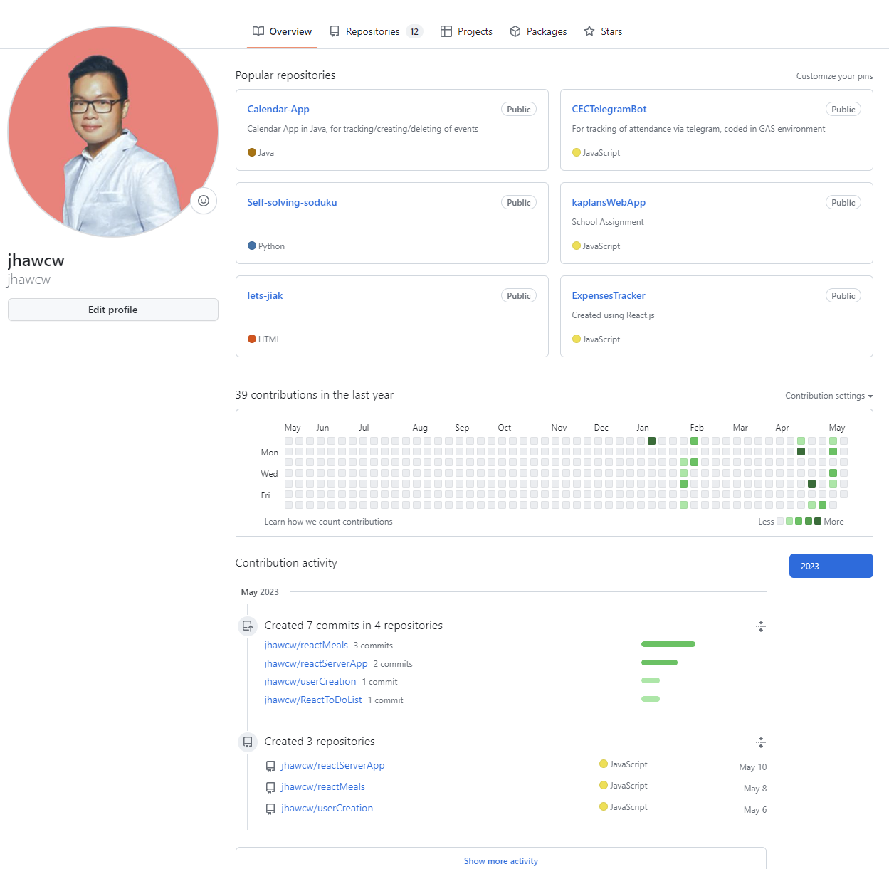
Technical Achievements
Created backend API and hosted web applications on Heroku
Implemented a static responsive webpage as a concept for understanding HTML and CSS
Committed a few React Apps to practice on the use of React Hooks
Created a Webhook based Telegram bot that uses Google Apps script to track attendance in the Singapore Armed Forces

Slide 15
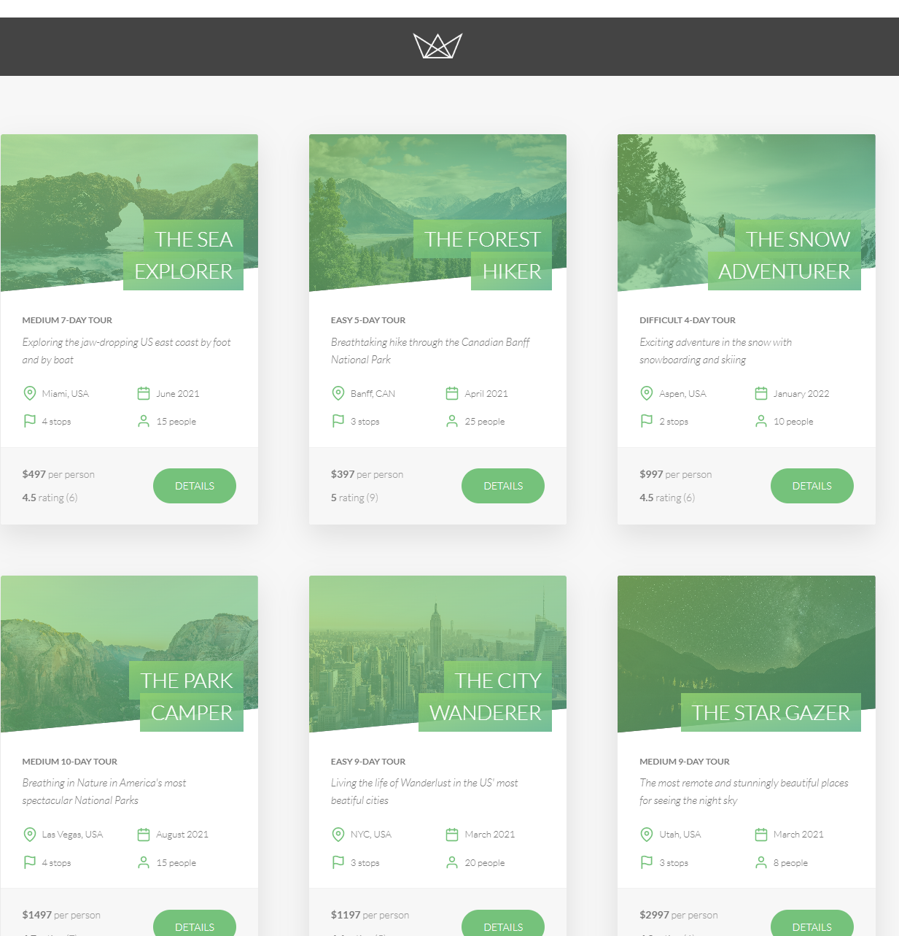
Technical Achievements
Backend project: Lets Tour
A web application that allows user to book and review different tours around the United States
Framework used: NodeJs, Pug Templates, ExpressJs, HTML & CSS, Javascript, MongoDB
Link: https://letstour.herokuapp.com/

Slide 16
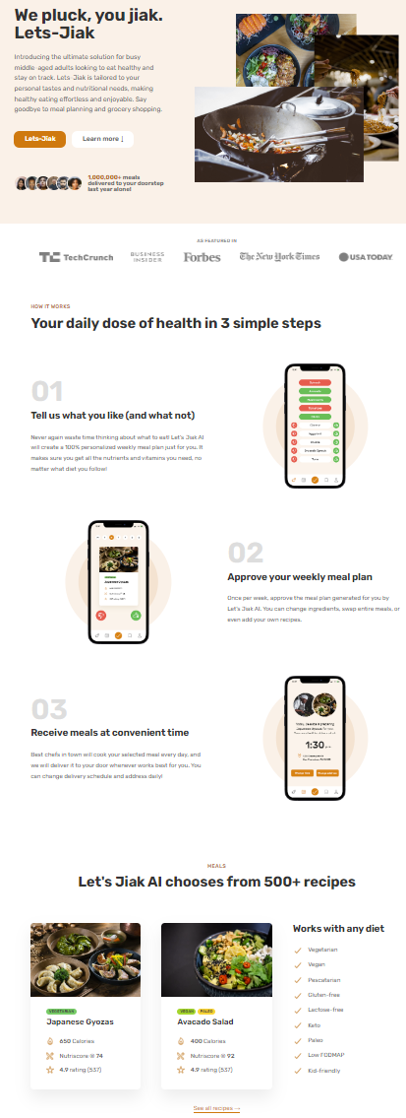
Technical Achievements
Frontend project: Let’s Jiak
A static webpage that allows user to choose their meals
Framework used:, HTML & CSS, Javascript
Link: https://letsjiak.netlify.app/

Slide 17
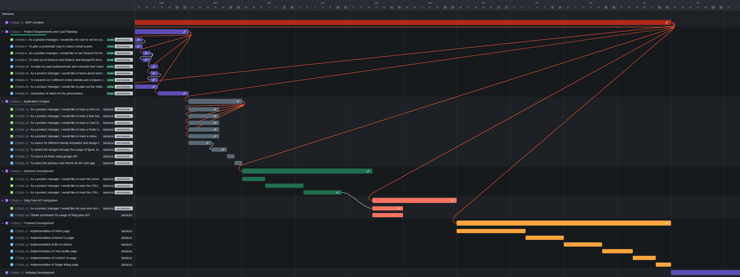
Project Planning
Project’s Jira: https://jhawcw.atlassian.net/jira/software/c/projects/CPSMS/boards/1/roadmap

Slide 18
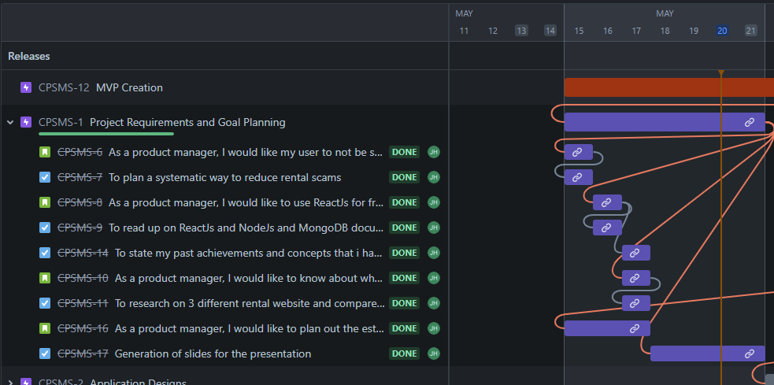
Project Planning
Project’s Jira: https://jhawcw.atlassian.net/jira/software/c/projects/CPSMS/boards/1/roadmap

Slide 19
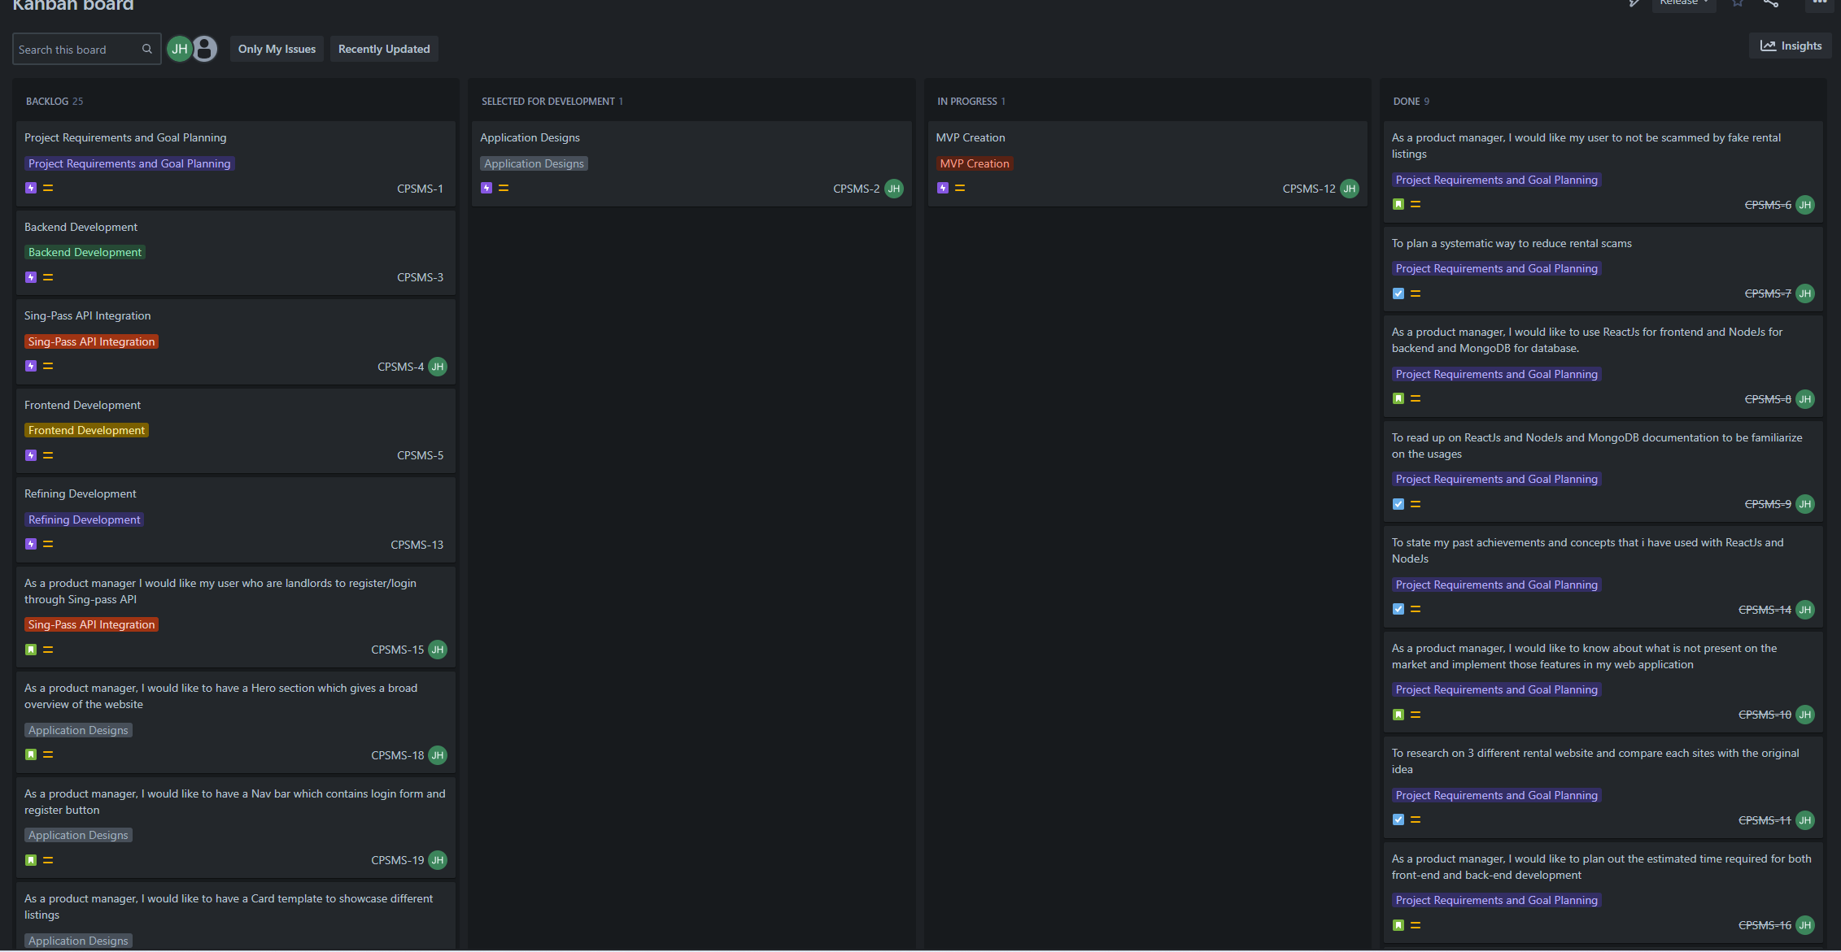
Project Planning – KanBan Board

Slide 20
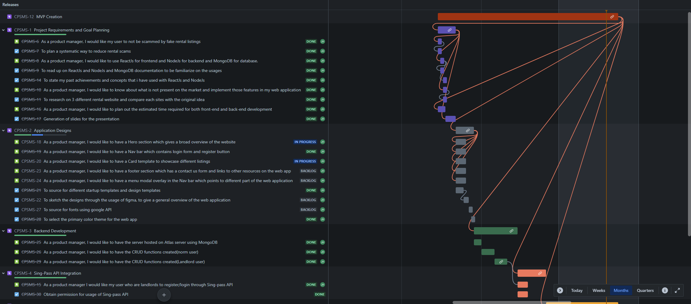
Project Progress - 1

Slide 21
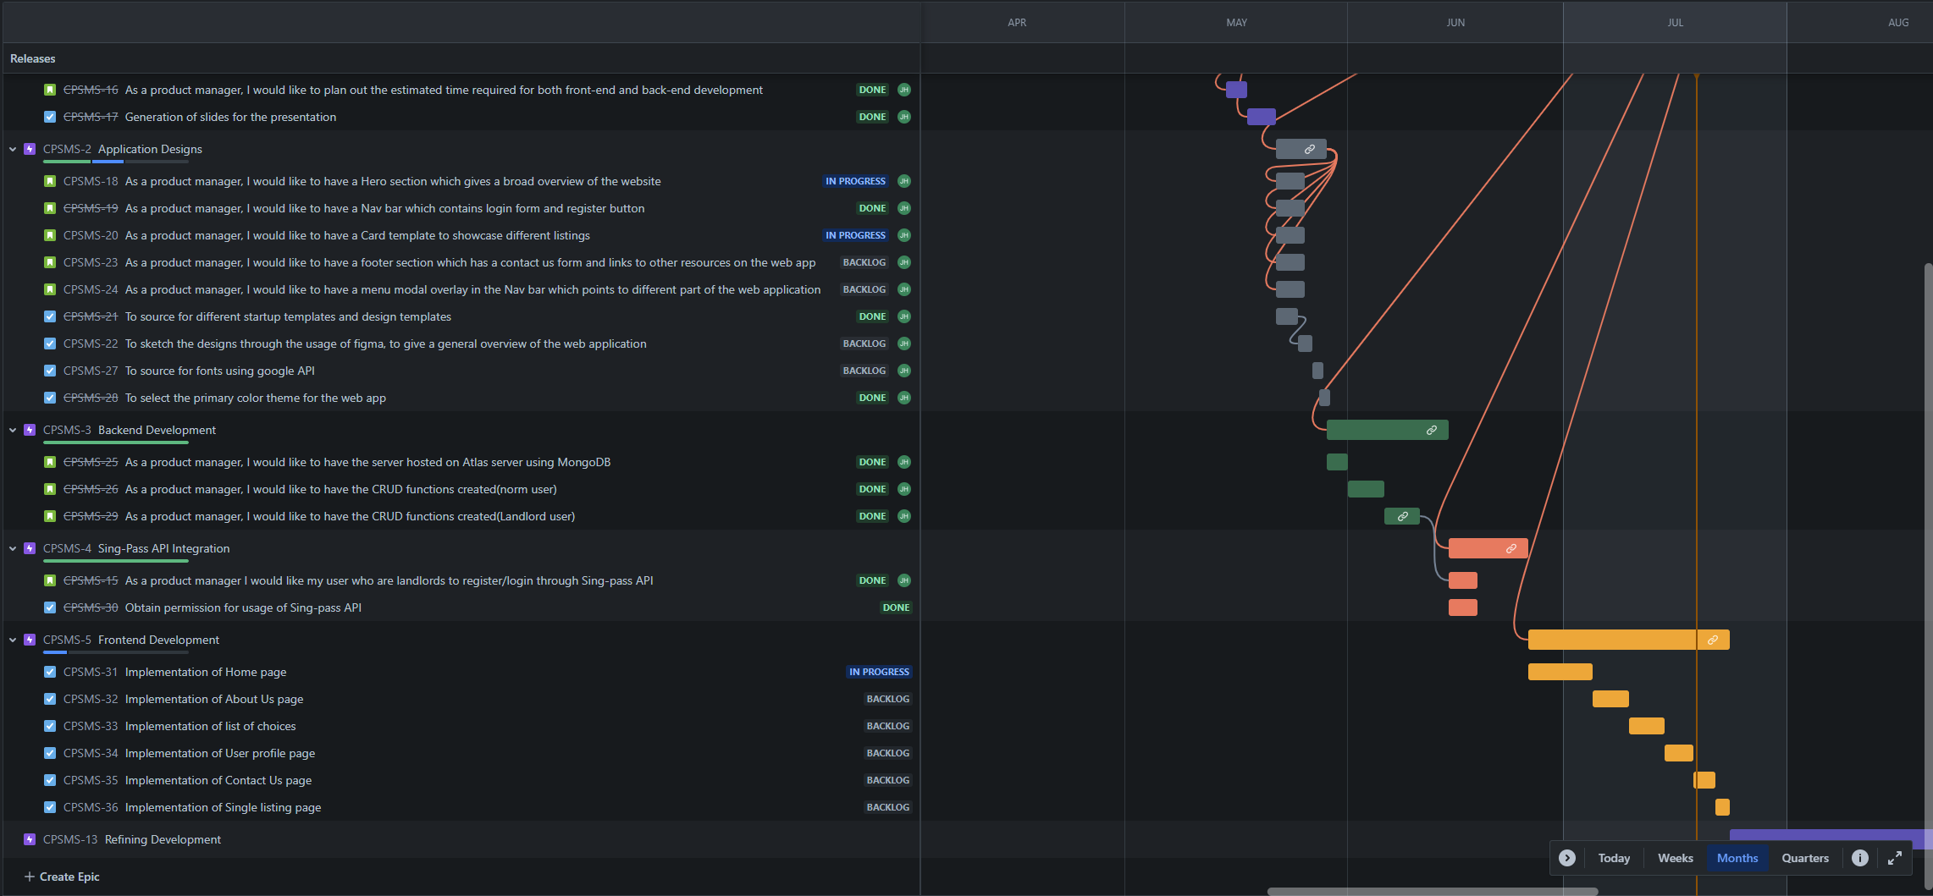
Project Progress - 2

Slide 22
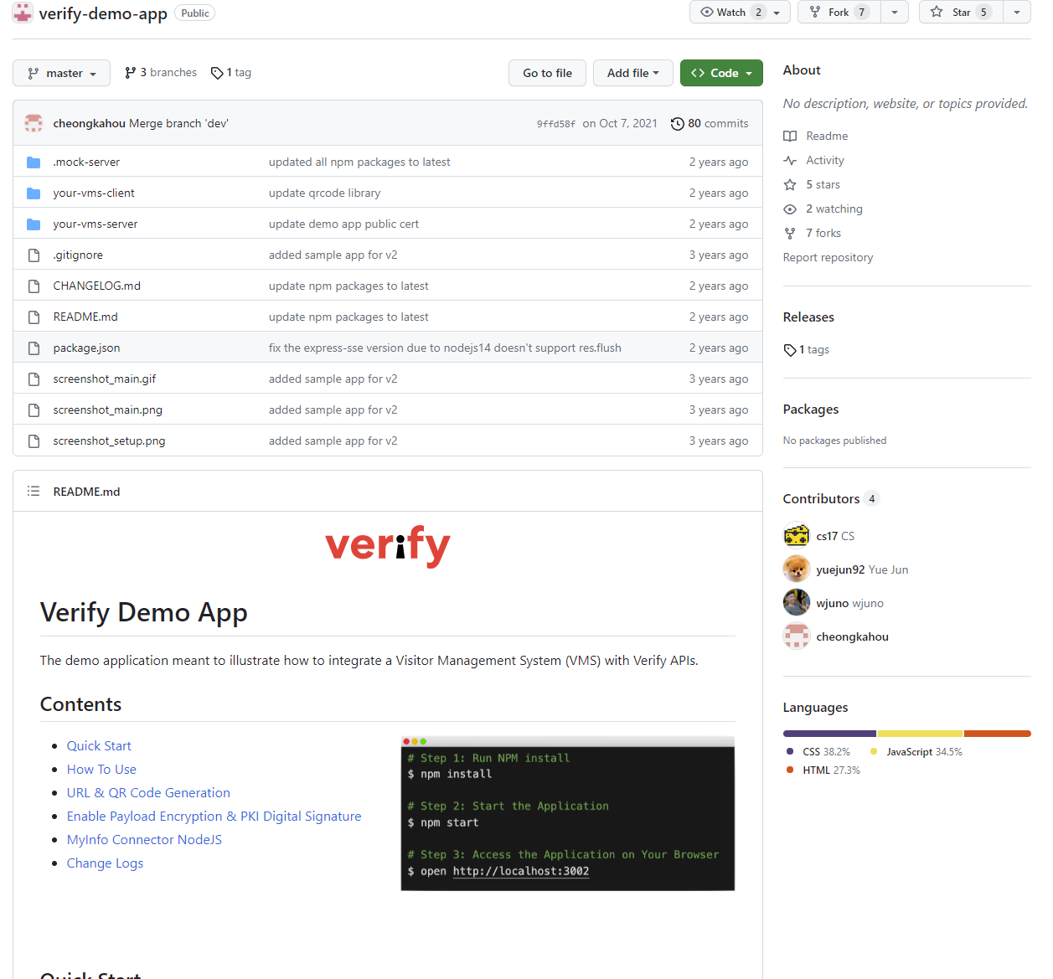
Challenges
Problems with obtaining permission to use actual Singpass
(ARCRA) A cooperate ID is required for approval of usage of singpass
Spent around 3 weeks of searching for alternatives
Found an alternate singpass server but standards and documentations are not updated
Linked up with Govt tech personnel and got intro to mock-Singpass
Spent another 1 week on tinkering with mock-Singpass api

Slide 23
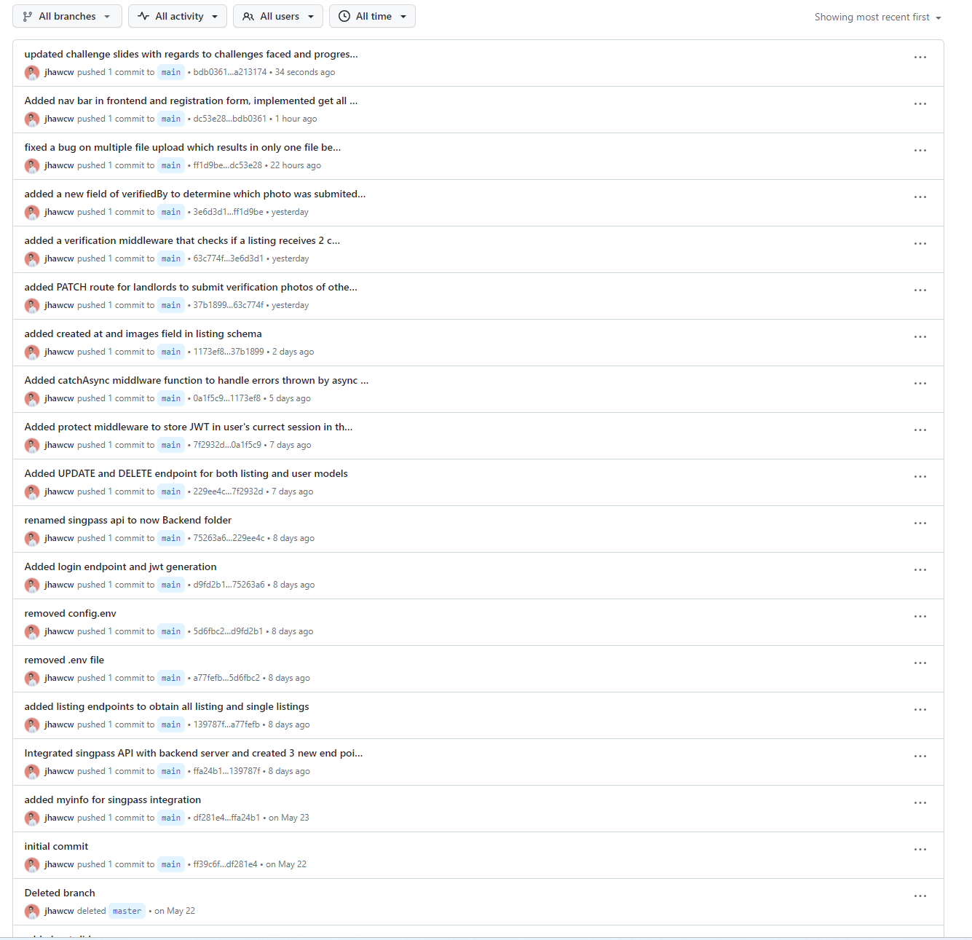
Github Logs

Slide 24
References
[1] L. Tang, 11 Nov 2023, “‘overwhelmed, defeated’: Expats face up to 70% rise in housing rents as prices hit record highs,” https://www.channelnewsasia.com/singapore/housing-rent-prices-expats-70-increase-landlords-tenants-3060231
[2] [1] N. H. M. Ali, 09 May 2023, “Cases of home rental scams jumped from 192 to 979 over the past year” , https://www.channelnewsasia.com/singapore/home-rental-scams-jump-cases-sun-xueling-3475761
[3] C. Co, 01 Jul 2021 ,“ “fair wear and tear” disputes over rental property: What can tenants and landlords do?”, https://www.channelnewsasia.com/singapore/fair-wear-and-tear-disputes-rental-property-tenants-landlords-1993706

